Slide 1
OPERATING SYSTEM

Slide 2
DEFINATION OF OS
An operating system is the interface between the user and the machine.

Slide 3
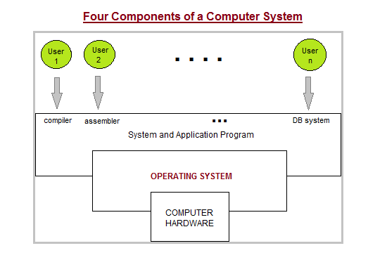

Slide 4
Some popular Operating Systems include :
Linux Operating System
Windows Operating System
MAC OS
IOS etc.

Slide 5
History of Operating Systems
The 1940's - First Generations
The 1950's - Second Generation
The 1960's - Third Generation
Fourth Generation

Slide 6
Multiprogramming
Multiprocessing
Multitasking

Slide 7
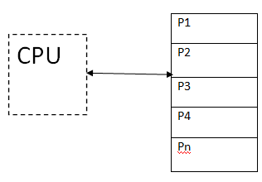
Multiprogramming
MAIN MEMORY

Slide 8
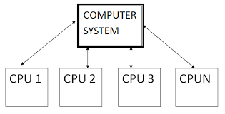
Multiprocessing

Slide 9
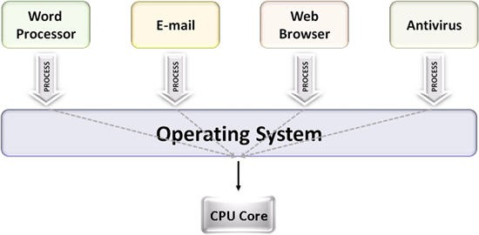
Multitasking

Slide 10
Context Switching
A context switching is a process that involves switching of the CPU from one process or task to another.
In this phenomenon, the execution of the process that is present in the running state is suspended and another process that is present in the ready state is executed by the CPU.

Slide 11
Types of Operating System

Slide 12
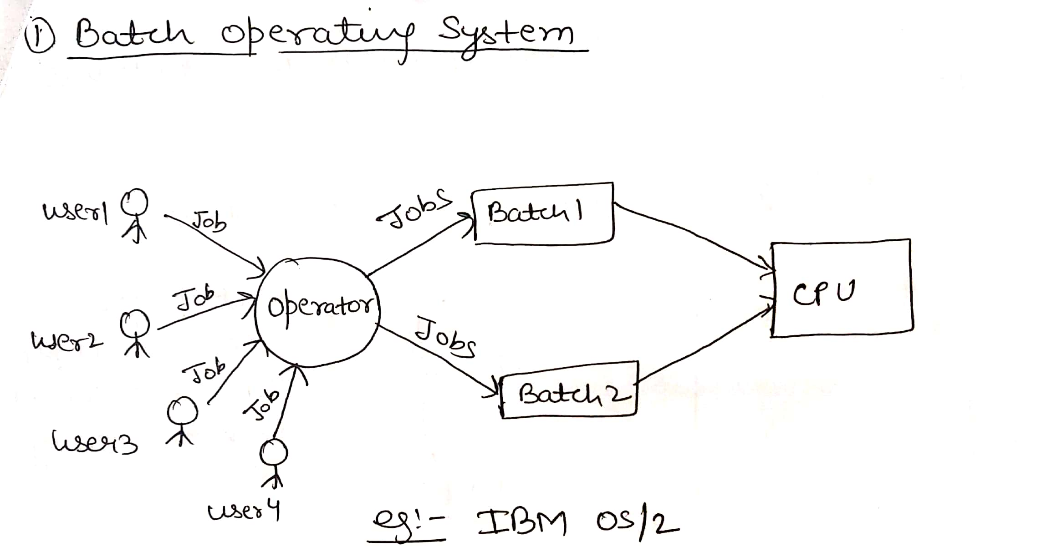
Batch operating system

Slide 13
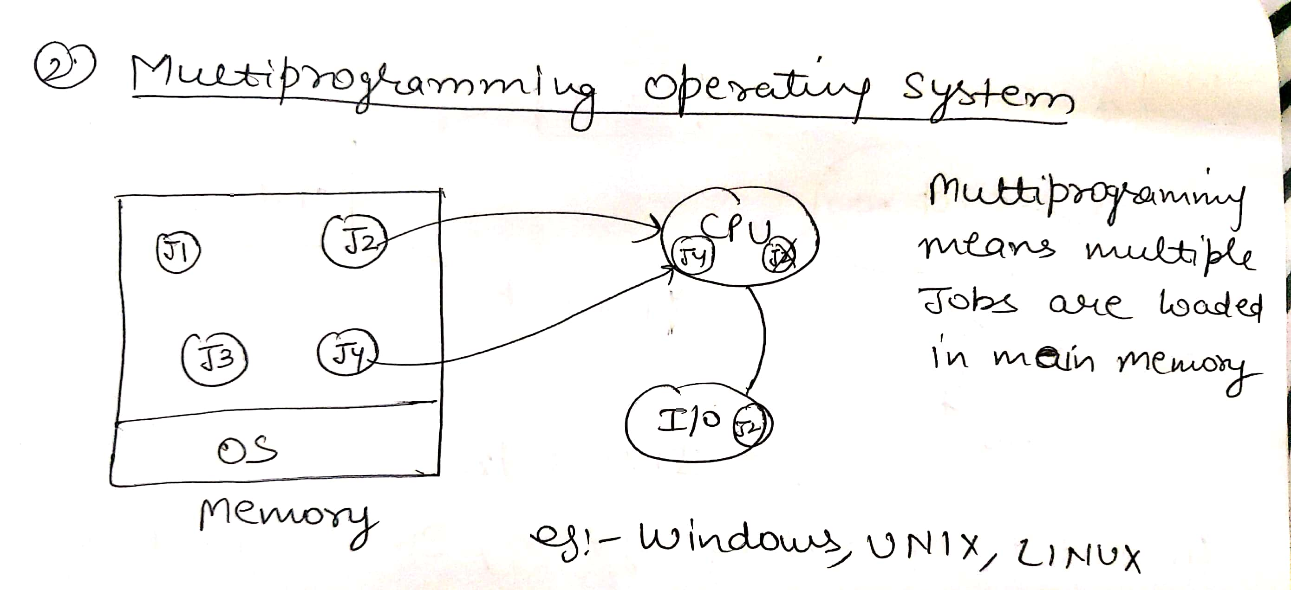
Multiprogramming operating system

Slide 14
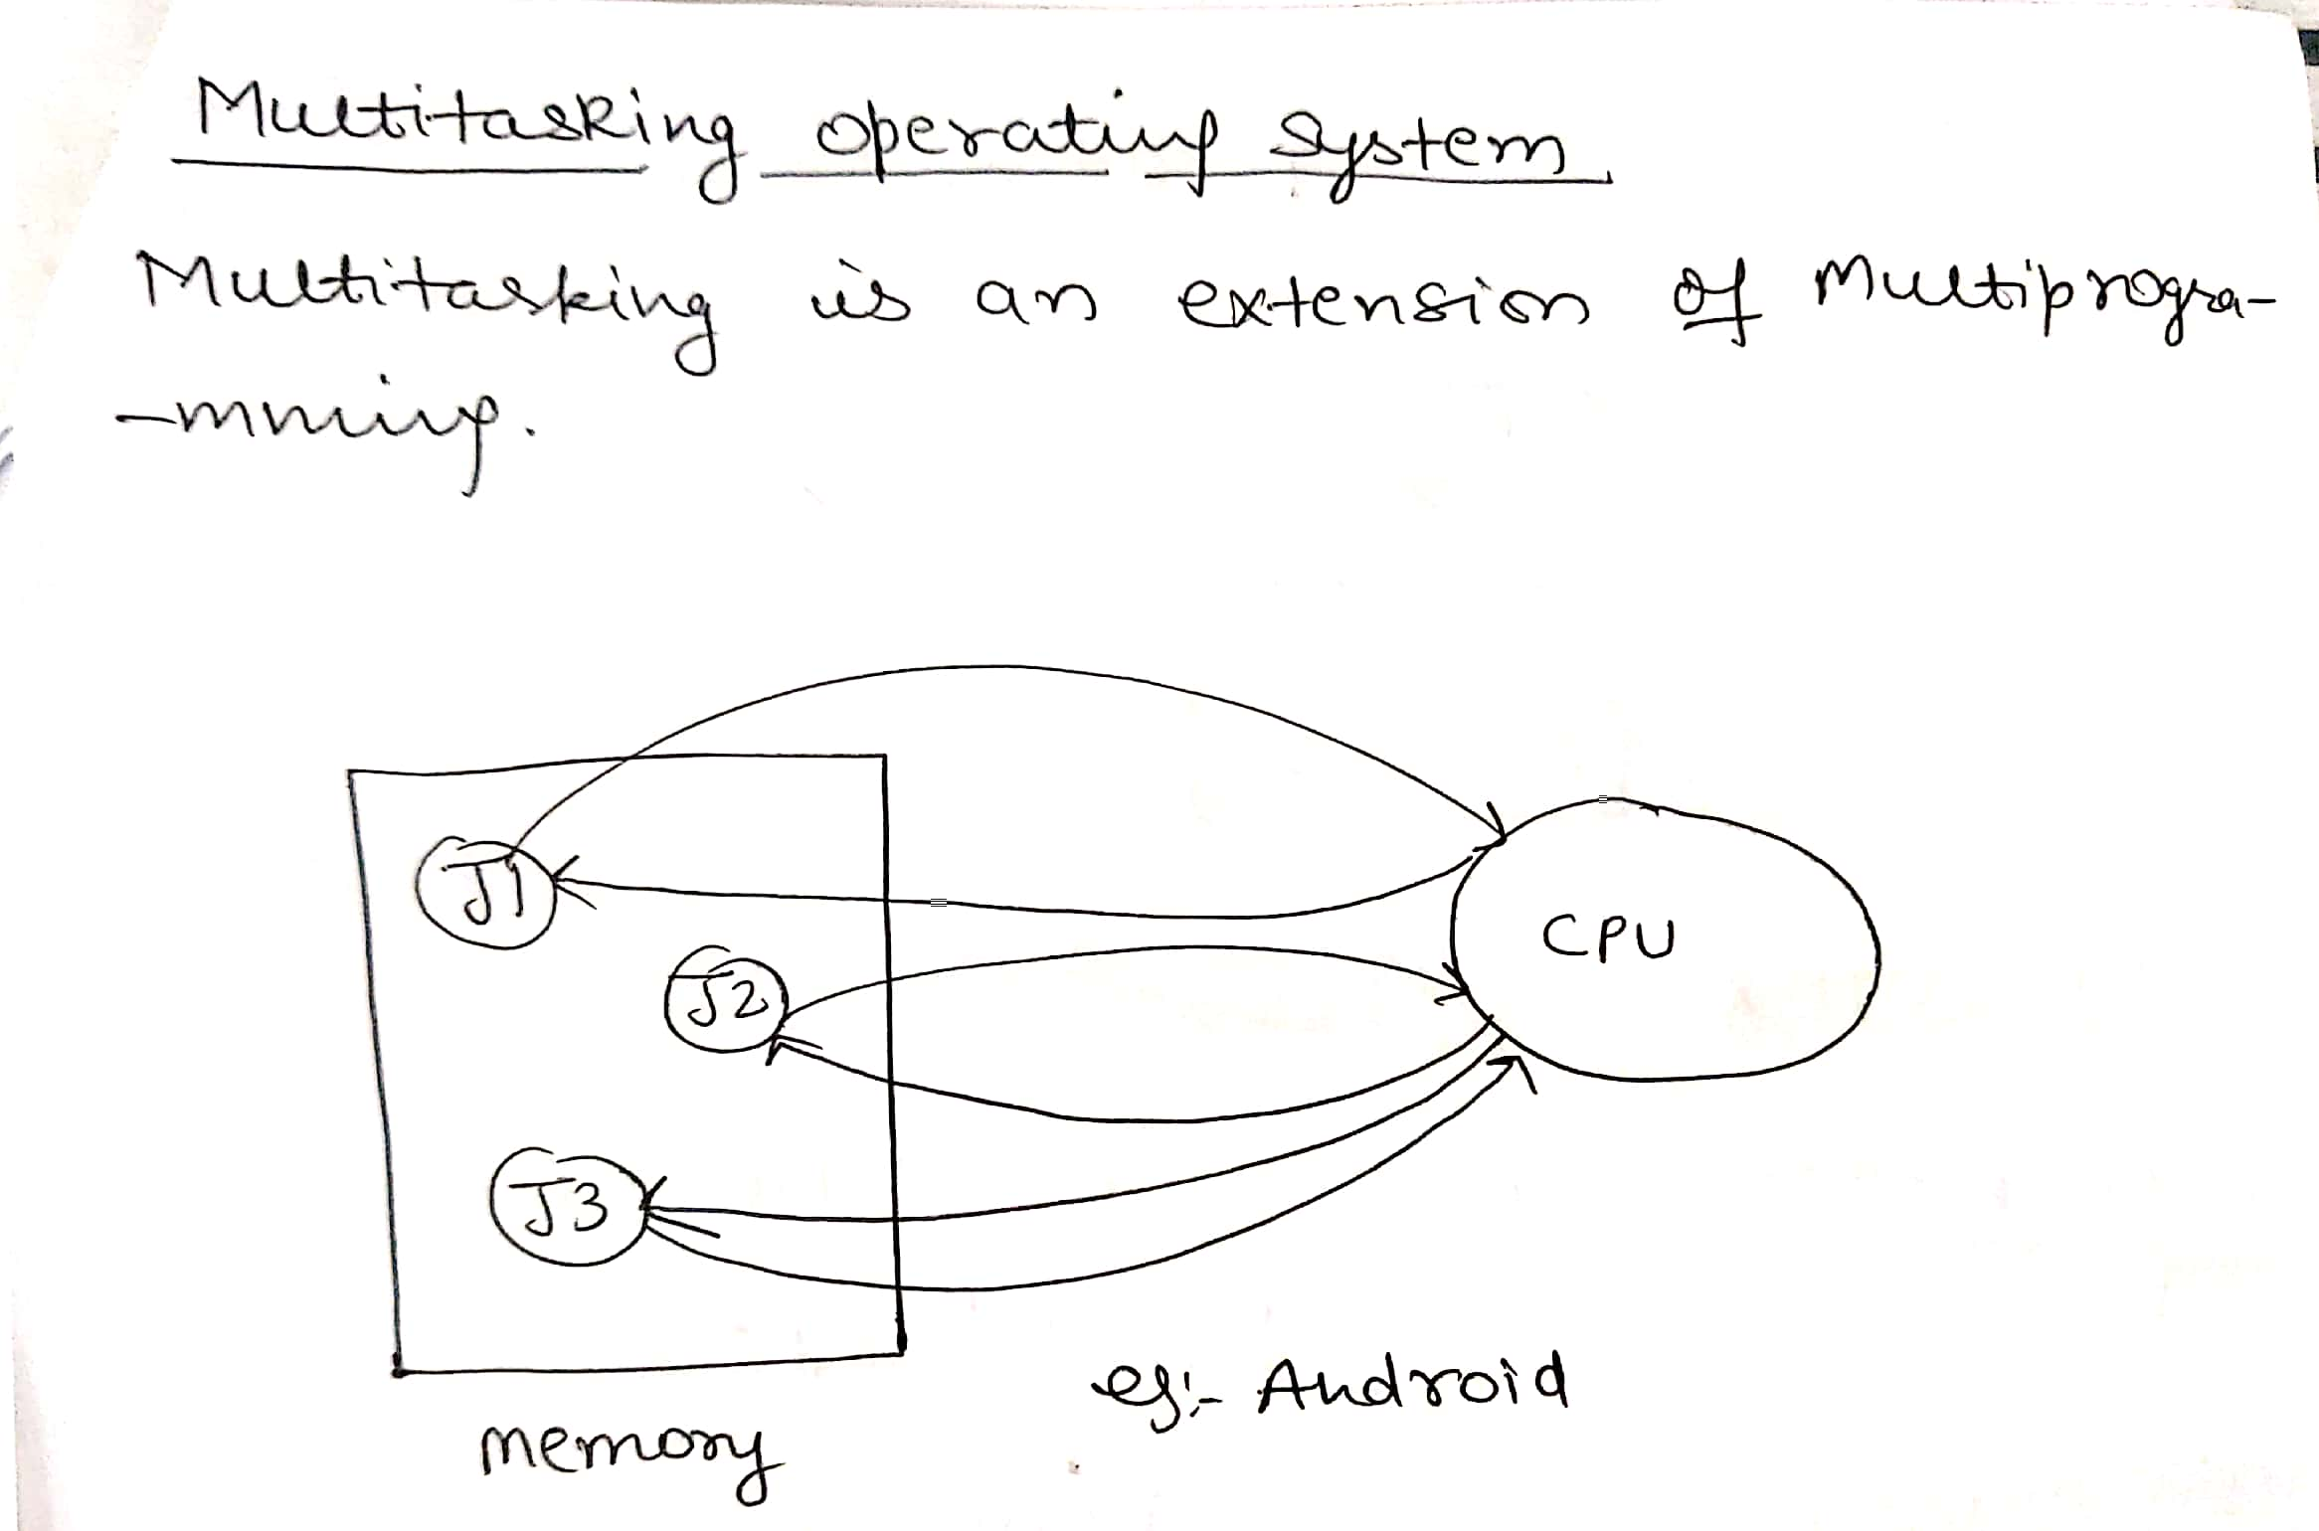
Multitasking operating system

Slide 15
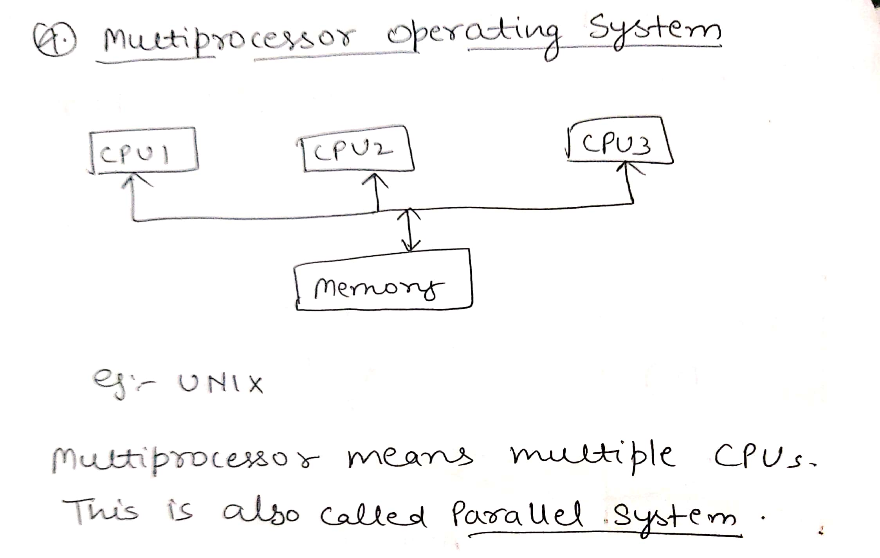
Multiprocessor operating system

Slide 16
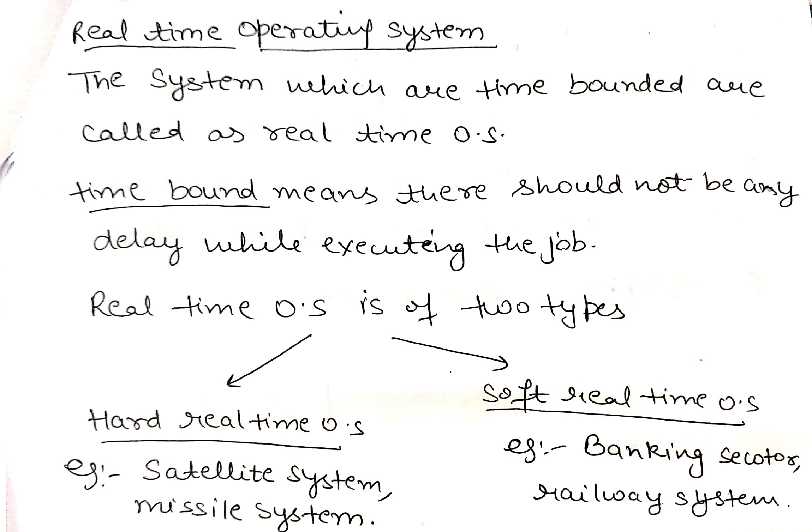
Real time operating system

Slide 17
Embedded operating system
This is a type of operating system that is embedded and specifically configured for a certain hardware configuration.

Slide 18
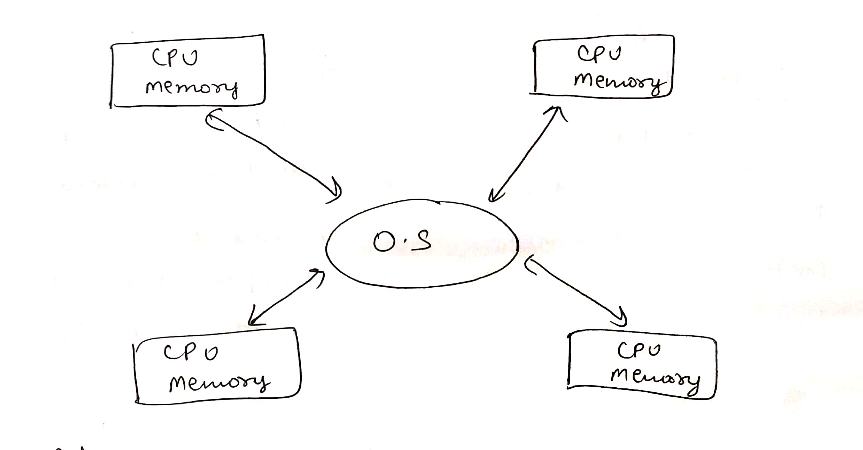
Distributed operating system

Slide 19
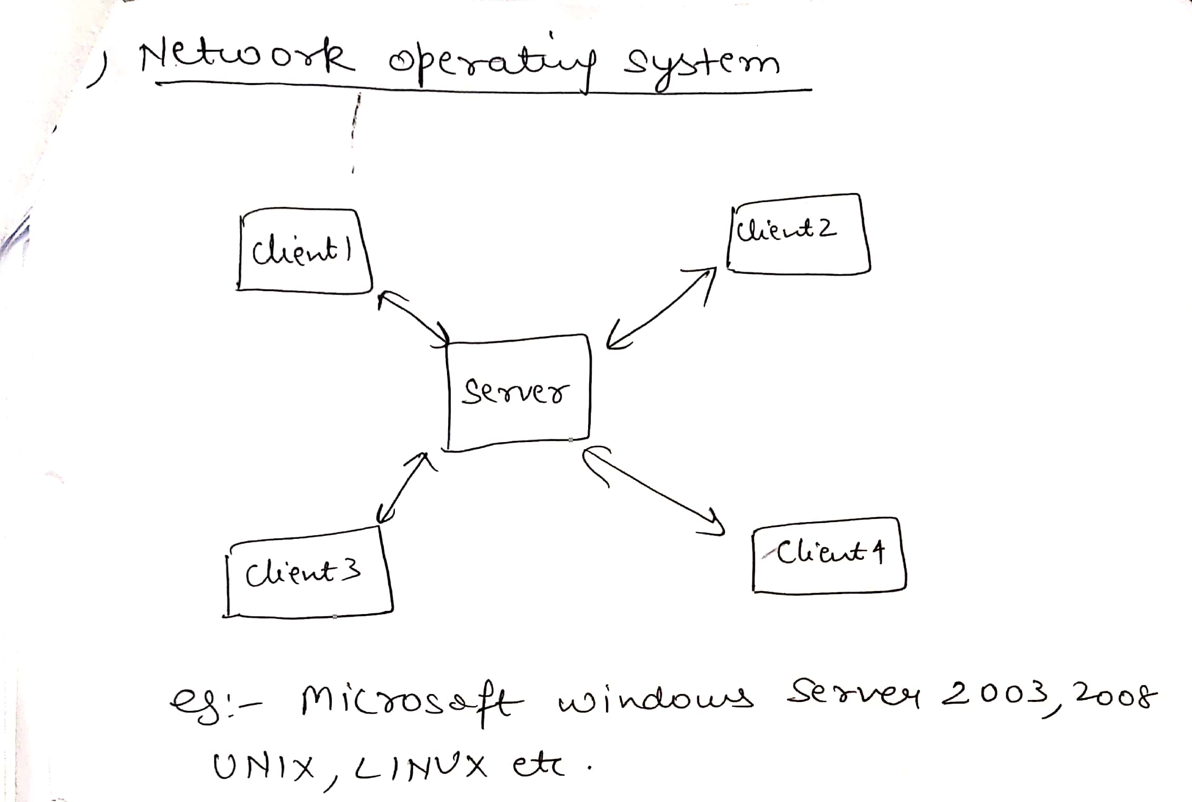
Network operating system

Slide 20
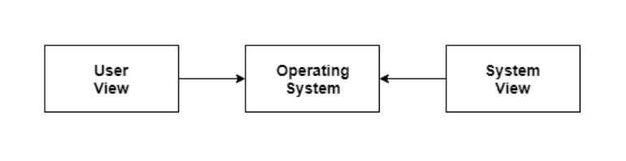
Two views

Slide 21
User View
The user view depends on the system interface that is used by the users.
There are some devices that contain very less or no user view because there is no interaction with the users. Examples are embedded computers in home devices, automobiles etc.

Slide 22
System View
According to the computer system, the operating system is the bridge between applications and hardware. It is most intimate with the hardware and is used to control it as required.

Slide 23
TYPES OF OPERATING SYSTEM STRUCTURE
MONOLYTHIC STRUCTURE
SIMPLE STRUCTURE
LAYERED STRUCTURE

Slide 24
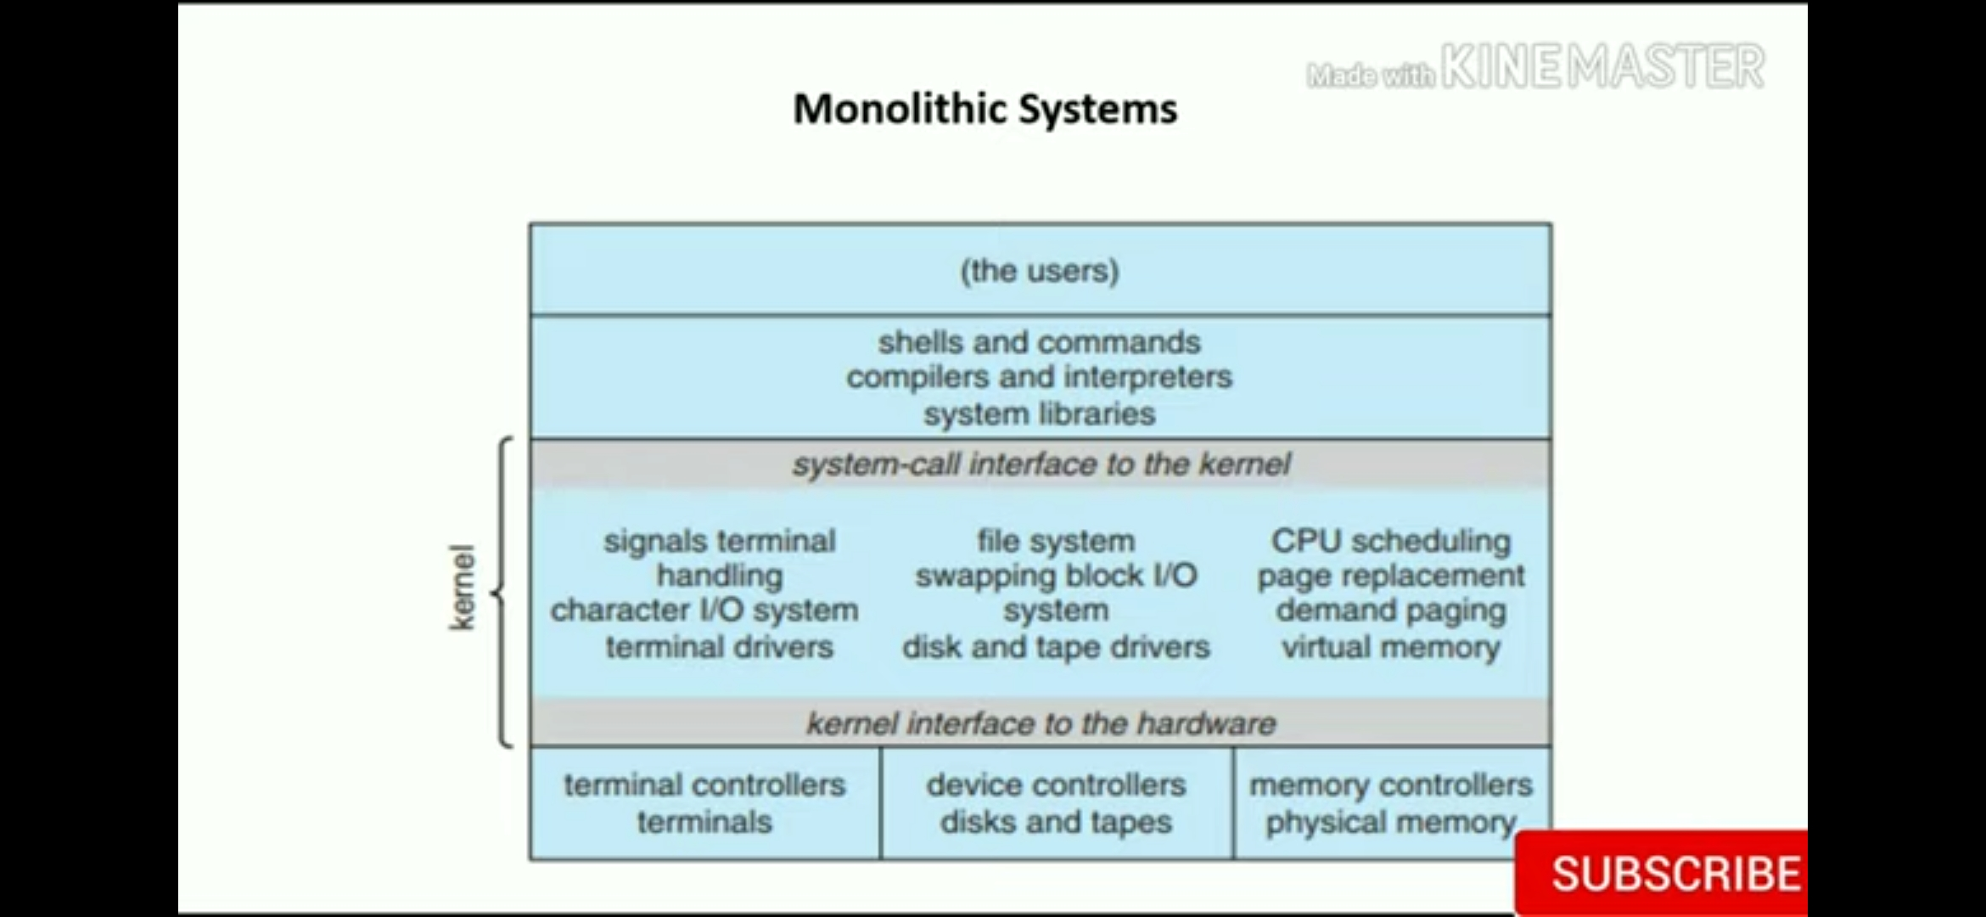
MONOLYTHIC STRUCTURE

Slide 25
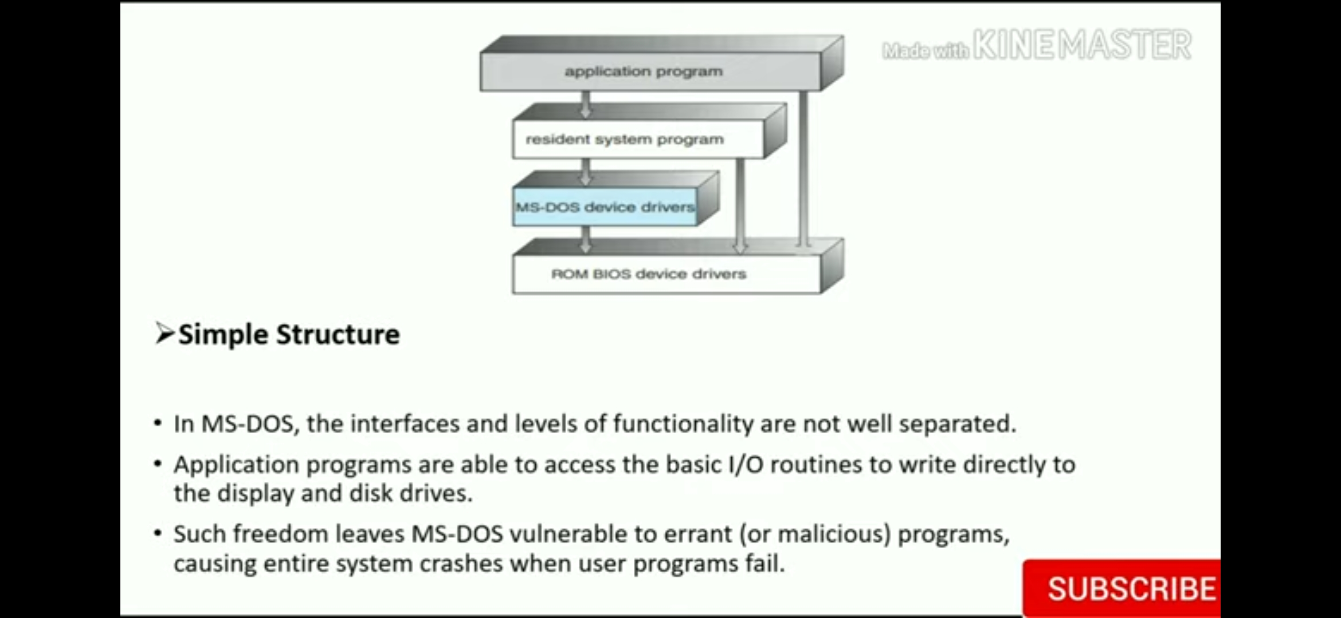
SIMPLE STRUCTURE

Slide 26
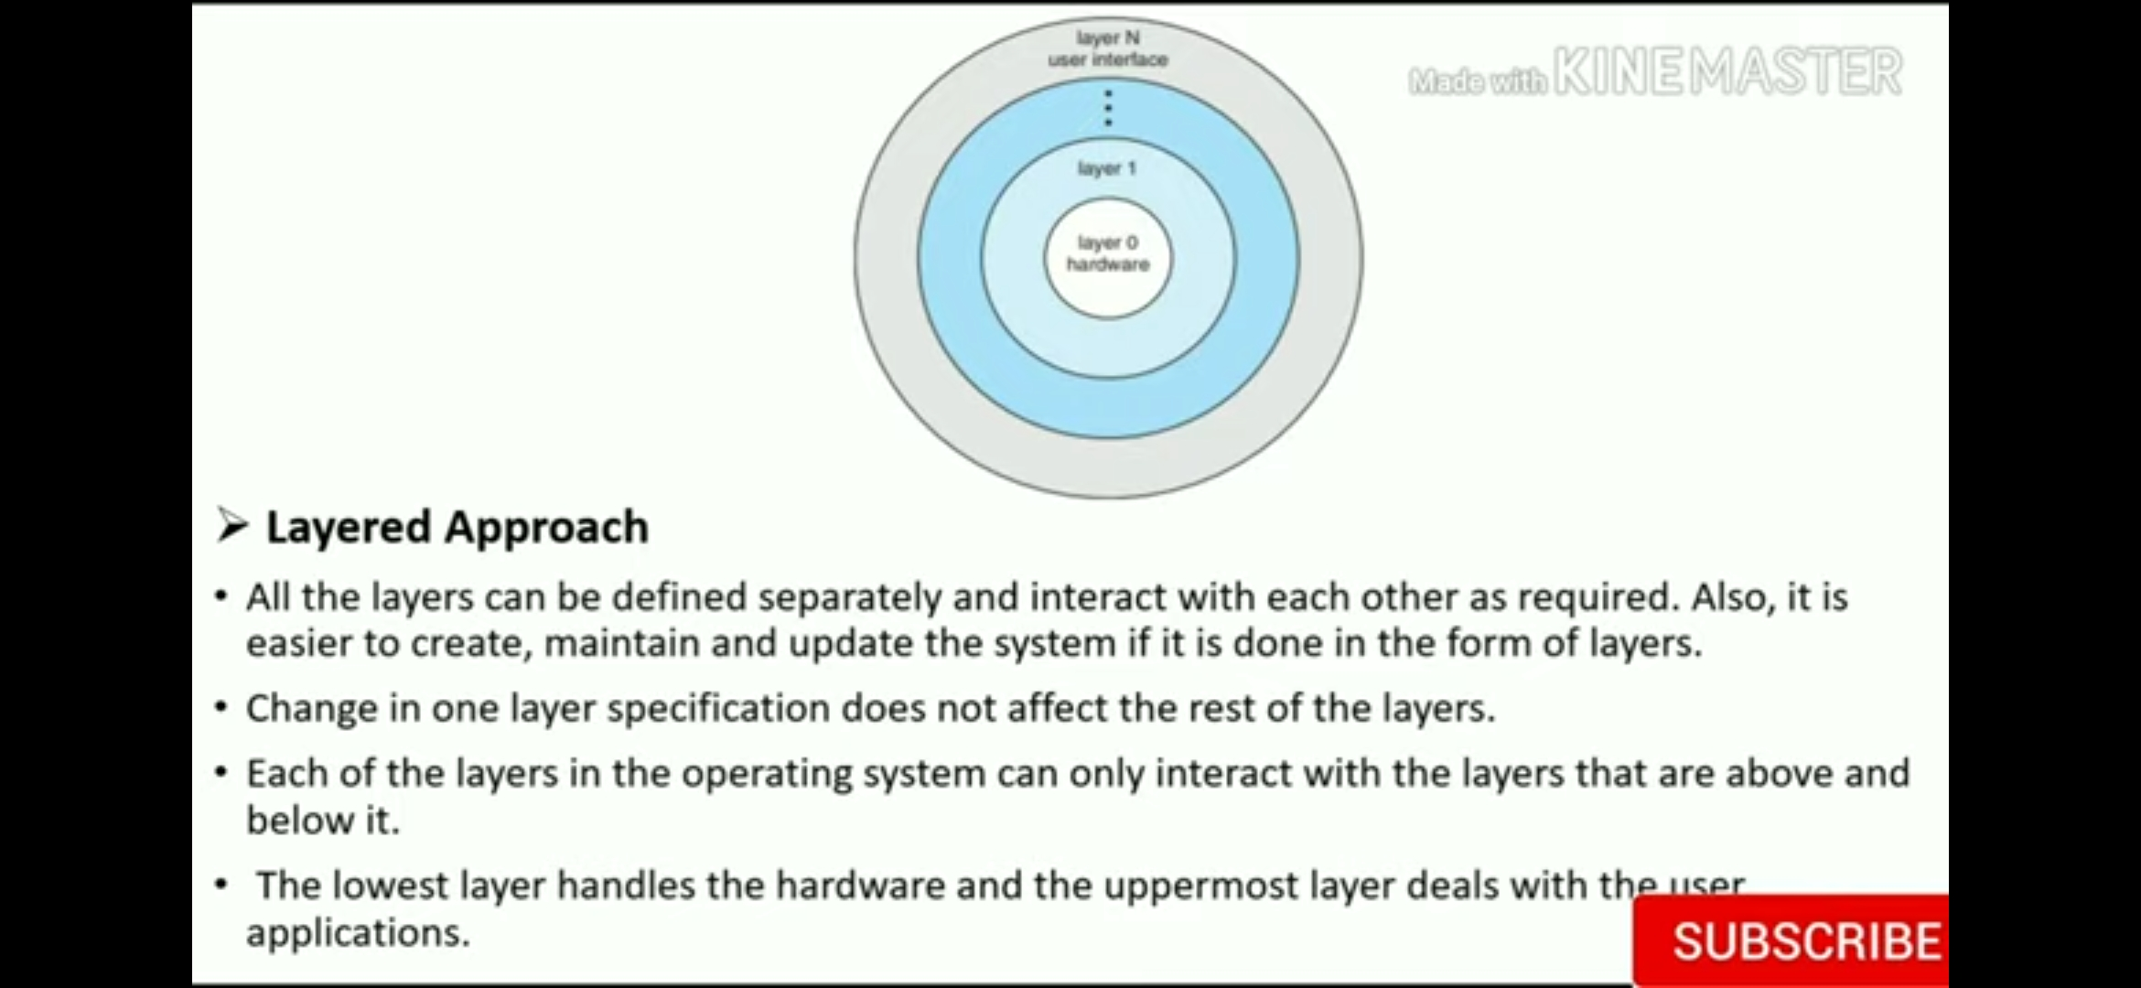
LAYERED STRUCTURE

Slide 27
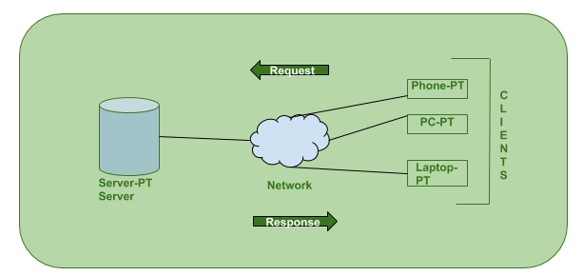
CLIENT SERVER MODEL

Slide 28
CLIENT SERVER MODEL
Client: Client is a computer (Host) i.e. capable of receiving information or using a particular service from the service providers (Servers).
Servers: Server is a remote computer which provides information (data) or access to particular services.

Slide 29
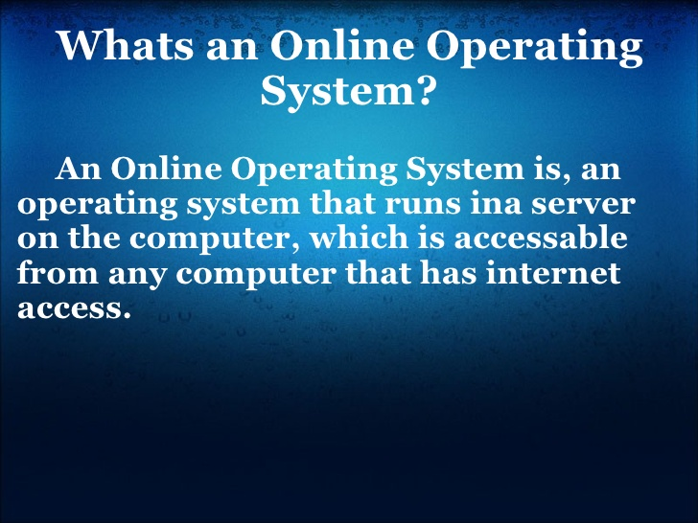

Slide 30
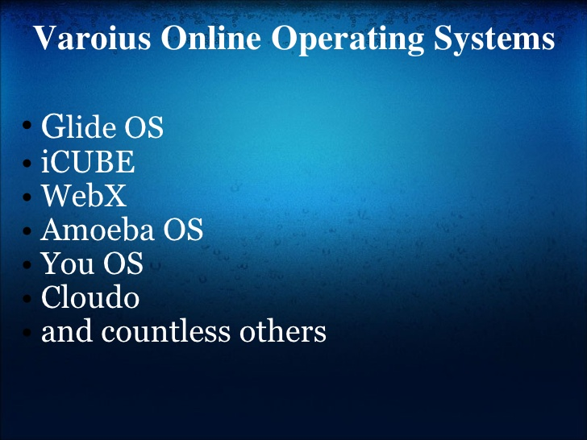

Slide 31
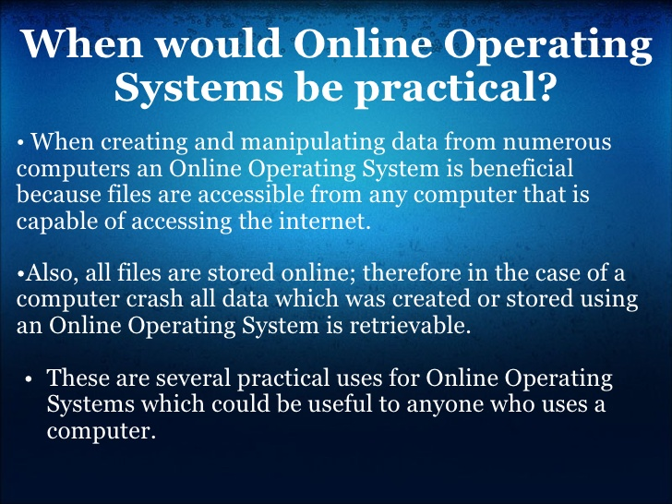

Slide 32
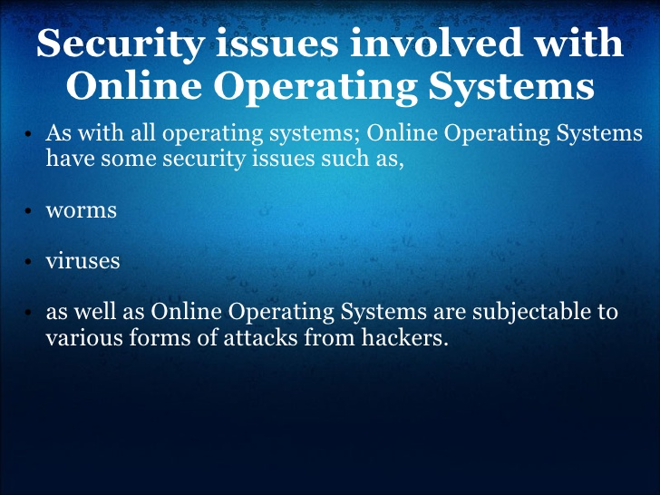

Slide 33
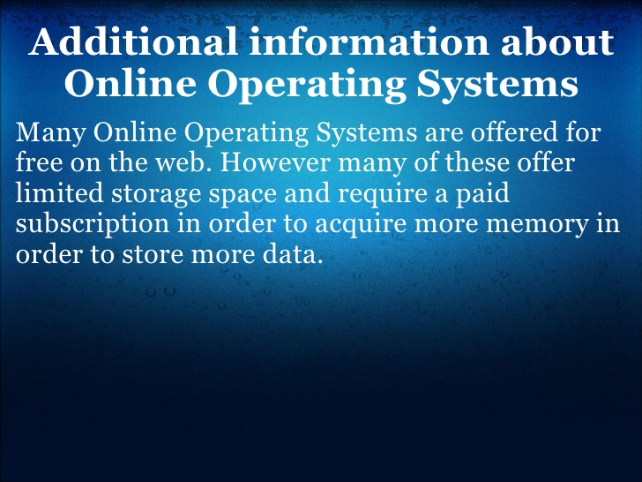

Slide 34
SYSTEM CALL IN OS
system call is the programmatic way in which a computer program requests a service from the kernel of the operating system it is executed on.
A system call is a way for programs to interact with the operating system.
A computer program makes a system call when it makes a request to the operating system’s kernel.

Slide 35
SYSTEM CALL IN OS
Services Provided by System Calls :
Process creation and management
Main memory management
File Access, Directory and File system management
Device handling(I/O)
Protection
Networking, etc.

Slide 36
Types of System Calls
There are 5 different categories of system calls –
Process control: end, abort, create, terminate, allocate and free memory.
File management: create, open, close, delete, read file etc.
Device management
Information maintenance
Communication

Slide 37
HISTORY OF UNIX
UNIX was originally developed at Bell Laboratories as a private research project by a small group of people starting in 1969.
This group had experience with a number of different operating systems research efforts in the 1970's.

Slide 38
HISTORY OF UNIX
The goals of the group were to design an operating system to satisfy the following objectives:
• Simple and elegant
• Written in a high level language rather than assembly language
• Allow re-use of code

Slide 39
HISTORY OF UNIX
UNIX had a relatively small amount of code written in assembly language (this is called the kernel) and the remaining code for the operating system was written in a high level language called C.

Slide 40
HISTORY OF UNIX
UNIX APPLICATION PROGRAMMING INTERFACE
In UNIX because the C language was written to be used to implement an operating system rather than a traditional "input-processing-output" application, use of these sophisticated features is quite easily done from the C language without writing any assembly language. In addition, the documentation for these sophisticated features is in the same format and location as the documentation for the normal application calls.

Slide 41
HISTORY OF UNIX
When UNIX was distributed, users could write applications in C and easily make use of all of the operating system facilities. This allowed application developers to quickly develop much more sophisticated applications using these facilities.

Slide 42
HISTORY OF UNIX
In 1984, the University of California at Berkeley released version 4.2BSD which included a complete implementation of the TCP/IP networking protocols.
The networking support included, remote login, file transfer, electronic mail, and other important features.
SUN Microsystems added NFS (Network File System), this ability to share and mutually use data was significantly enhanced.

Slide 43
HISTORY OF UNIX
The strength of UNIX is its portability across multiple vendor hardware platforms, vendor independent networking, and the strength of its application programming interface. These benefits are so strong that the relative weak end-us

Slide 44
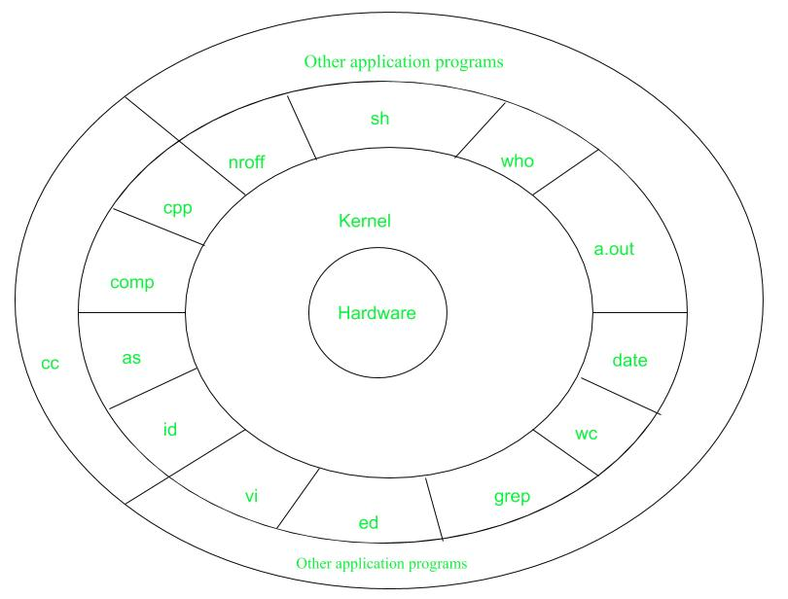
UNIX STRUCTURE

Slide 45
UNIX STRUCTURE
Layer-1: Hardware – It consists of all hardware related information.
Layer-2: Kernel – It interacts with hardware and most of the tasks like memory management, task scheduling, and management are done by the kernel.
Layer-3: Shell commands – Shell is the utility that processes your requests. When you type in a command at the terminal, the shell interprets the command and calls the program that you want.There are various commands like cp, mv, cat, grep, id, wc, nroff, a.out and more.
Layer-4: Application Layer – It is the outermost layer that executes the given external applications

Slide 46
SHELL IN UNIX
A Shell provides you with an interface to the Unix system. It gathers input from you and executes programs based on that input. When a program finishes executing, it displays that program's output.
Shell is an environment in which we can run our commands, programs, and shell scripts. There are different flavors of a shell, just as there are different flavors of operating systems. Each flavor of shell has its own set of recognized commands and functions.

Slide 47
Shell Types
In Unix, there are two major types of shells −
Bourne shell − If you are using a Bourne-type shell, the $ character is the default prompt.
C shell − If you are using a C-type shell, the % character is the default prompt.
The Bourne Shell has the following subcategories −
Bourne shell (sh)
Korn shell (ksh)
Bourne Again shell (bash)
POSIX shell (sh)
The different C-type shells follow −
C shell (csh)
TENEX/TOPS C shell (tcsh)

